Slide 1
A.4 ASCII Encoding – May 01
Agenda
Module A.4 Encryption Methods
Decryption Challenge
Discussion: ASCII Encoding
Module A.4: Begin Today
Module D.3 Encryption Methods
Complete for Homework
Upcoming
Tomorrow: Continue A.4

Slide 2
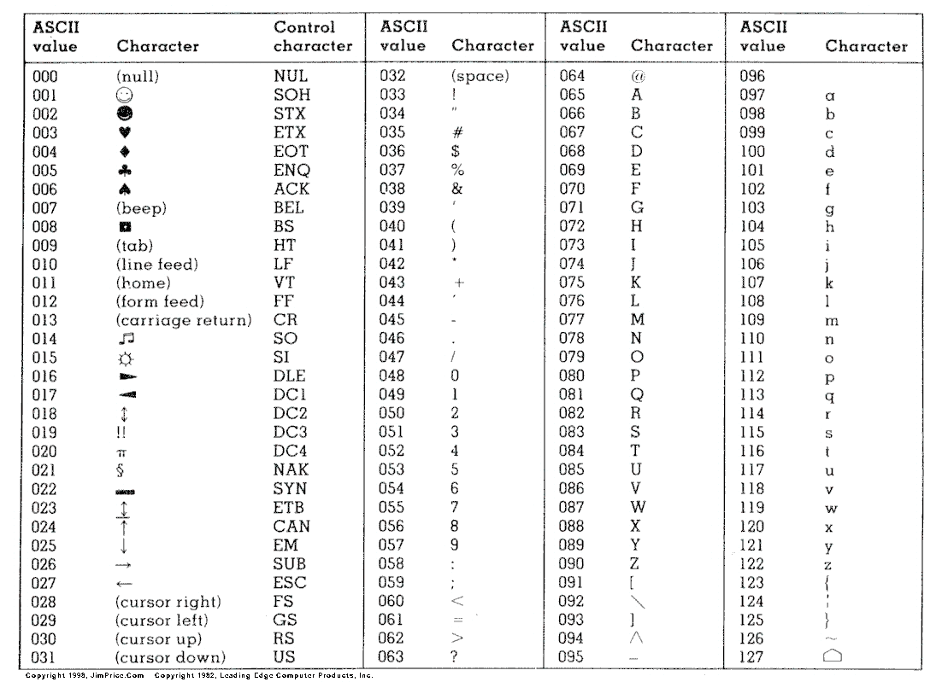
ASCII Encoding
Python Code
ord() command
ord('a')
ord('A')
chr() command
chr(97)
chr(65)

